Slide 1
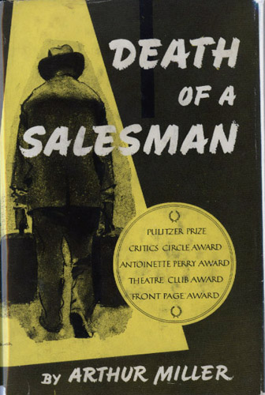
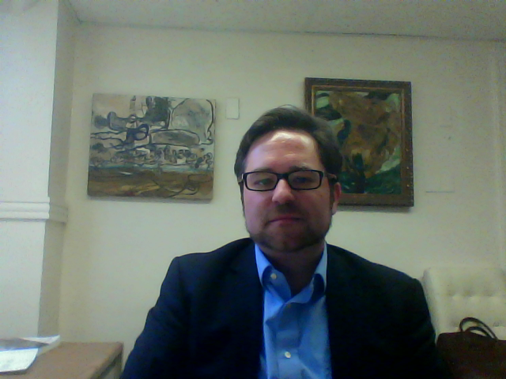
TODAY:
Beginning Arthur Miller’s Death of a Salesman (1949)

Slide 2

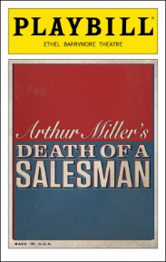

The “Hamilton” of its Day?
Death of a Salesman (1949)
-- Tony Awards for Best Play, Best Author, and Best Director
-- New York Drama Critics’ Circle Award
-- Pulitzer Prize for Drama
-- Major Critical and Commercial Success
-- Considered a classic outside of the US
-- Revived on Broadway 4 times
-- At least 6 film versions in English (1 produced in the USSR)

Slide 3
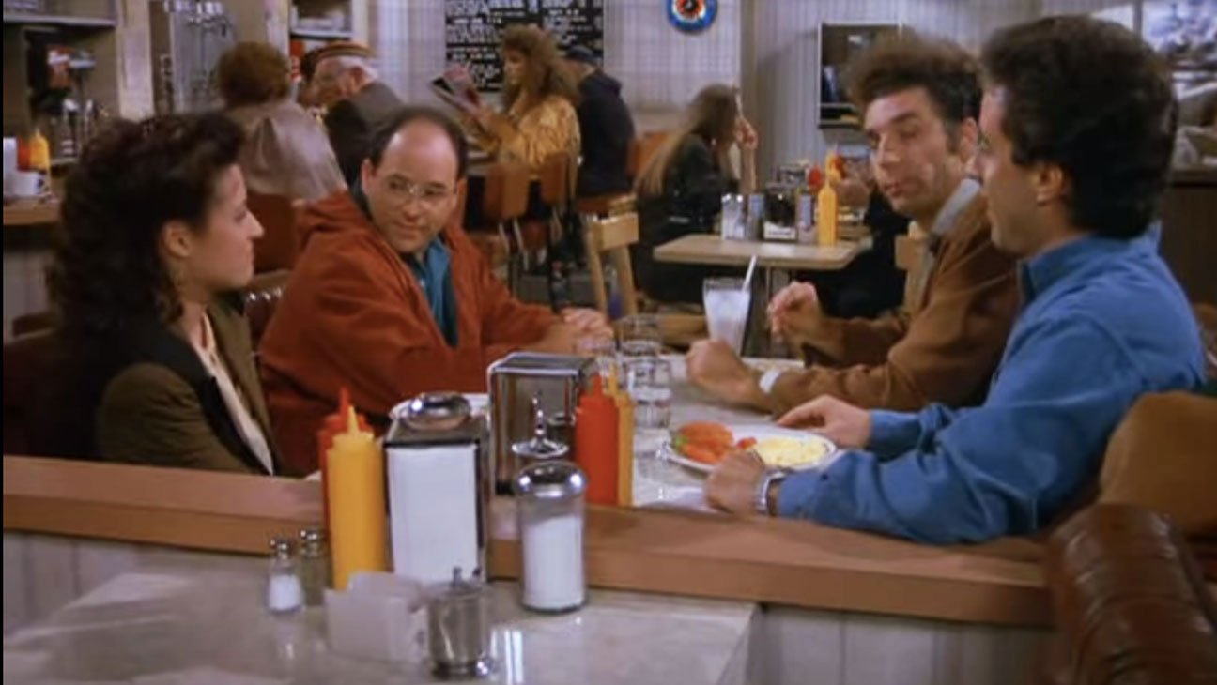

From popular 90s sitcom Seinfeld, episode entitled “The Subway” (1991)
Elaine: Ok, what time is your job interview George?
George: 9:45
Jerry: Remember, don't whistle on the elevator.
George: Why not?
Jerry: That's what Willie Loman told Biff before his interview, in 'Death of a Salesman'.
George: What, you are comparing me to Biff Loman? Very encouraging. The biggest loser in the history of American literature!

Slide 4

Overarching Questions:
-- How can we explain the play’s central position in the history of American drama?
-- How does the play juggle different ideas of “success”?
-- How is reading a play different from reading fiction or poetry?
Questions for the first half of the play:
-- What are some of the central conflicts/problems in the play so far?
-- What’s unique about the physical staging of the play?
-- What have we learned about each character, and what does each character seem to want?
-- What questions are raised that we’ll need to see resolved?

Slide 5
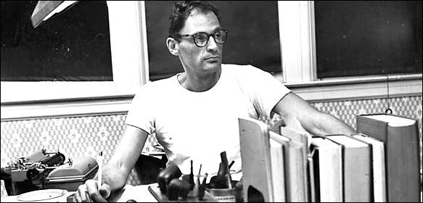
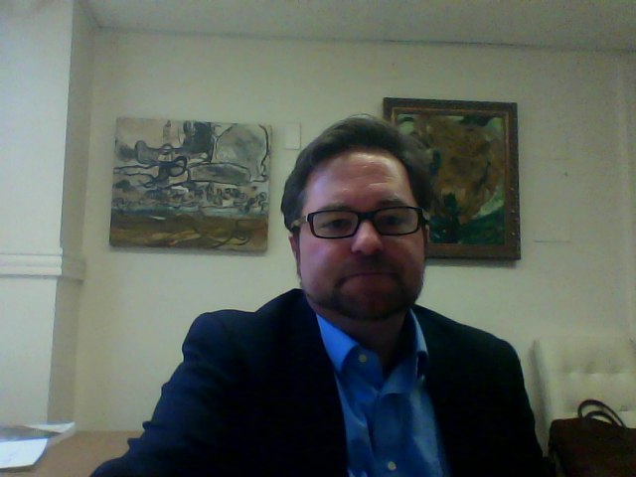
Arthur Miller (1915-2005) On the Function of the Theatre
“To me the theatre is not a disconnected entertainment. It's the sound and the ring of the spirit of the people at any one time. It is where a collective mass of people through the genius of one author is able to project its terrors and its hopes and to symbolize them.”

